Slide 1
EDA AND MACHINE LEARNING
ON BANK CUSTOMER CHURN
PREDICTION
UNDER:LUMA CORE AI
DONE BY:T.V.SUSMITHA

Slide 2
Contents Covered:
Business Understanding of the DataSet.
Visual Analysis of the data.
Introduction of MachineLearning.
KNN Algorithm
DecisionTree Algorithm
Naive Bayes Algorithm
Conclusion

Slide 3
Basic Information about Data:
The bank customer churn dataset is a commonly used dataset for predicting customer churn in the banking industry.
The dataset includes the following attributes:
Customer ID: A unique identifier for each customer
Credit Score: A numerical value representing the customer's credit score
Geography: The country where the customer resides (France, Spain or Germany)
Gender: The customer's gender (Male or Female)
Age: The customer's age.
Tenure: The number of years the customer has been with the bank
Balance: The customer's account balance
HasCrCard: Whether the customer has a credit card (1 = yes, 0 = no)
IsActiveMember: Whether the customer is an active member (1 = yes, 0 = no)
EstimatedSalary: The estimated salary of the customer
Exited: Whether the customer has churned (1 = yes, 0 = no)

Slide 4
Business Understanding of Data:
It contains information on bank customers who either left the bank or continue to be a customer.
From a business perspective it is essential to learn why customers leave a bank and what measures can be taken to retain them. Here are the primary aspects to consider:
Demographics: Analyzing age, income, and location of customers who churn to identify groups at higher risk.
Account Tenure: Observing the length of time customers typically stay with the bank before leaving to anticipate and address potential causes of churn.
Product Usage: Studying which banking products (e.g., loans, credit cards, savings accounts) are most common among churned customers.

Slide 5
Introduction of MachineLearning:
Machine learning (ML) is a branch of artificial intelligence (AI) that focuses on developing algorithms and models that allow computers to learn from data and make predictions.
There are three types :
Supervised Learning: Where the algorithm is trained on labeled data, meaning the input comes with known outputs.
Unsupervised Learning: Where the algorithm works with unlabeled
data ,trying to find hidden patterns or groupings.
Reinforcement Learning: Involves learning by interacting with
an environment,receiving feedback in the form of rewards
or punishments

Slide 6
Modeling the data:
Supervised Learning Model:Here,the target variable Exited is Numerical,so we are using Regression techniques in a data such as:
Linear Regression:Here,we are using linear regression to predict the
Exited values which gives the information whether the customer has
churned or not(1=yes,0=No)
KNeighborsRegressor:In training section, we are using KNeighborsRegressor to predict the nearest datapoints.
DecisionTreeRegressor:The algorithm starts at the root node and recursively splits the data based on the feature that provides the best separation of classes.

Slide 7
Feature Engineering :
Encoding Categorical Variables:Use techniques such as labelencoding or one hot encoding to convert the categorical columns into the numerical columns for machine understanding.
Scaling the data:Here,we are using Standarisation method by using(StandardScaler)which is used to normalise the numerical features and making the model more stable and accurate for distance-based algorithms such as KNN.

Slide 8
Model Evaluation:
By using Mean Squared Error we can evaluate the Model and the Classification Report gives the output of the Model.
The Accuracy score and Classification Report varies for different algorithms and choose the best performance one.
The Mean Squared Error varies for different algorithms.

Slide 9
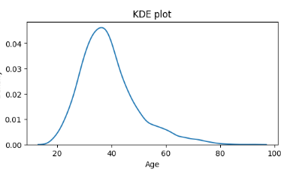
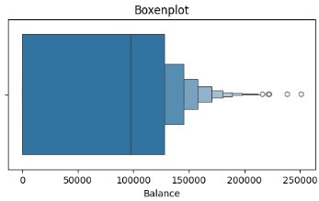
Visualisation
The above plot is the KDE plot of Age.
The x-axis represents the age variable,and y-axis represents the density.
The curve shows a clear peak around the age of 40,that it is common range in the data.
The above plot is the Boxenplot of Customer Balance.
The x-axis represents the "Balance" variableThe thick vertical line inside the largest box marks the median balance,which is 100,000.
The plot shows a heavy concentration of data in the lower balance range,data points clustered below 100,000.

Slide 10
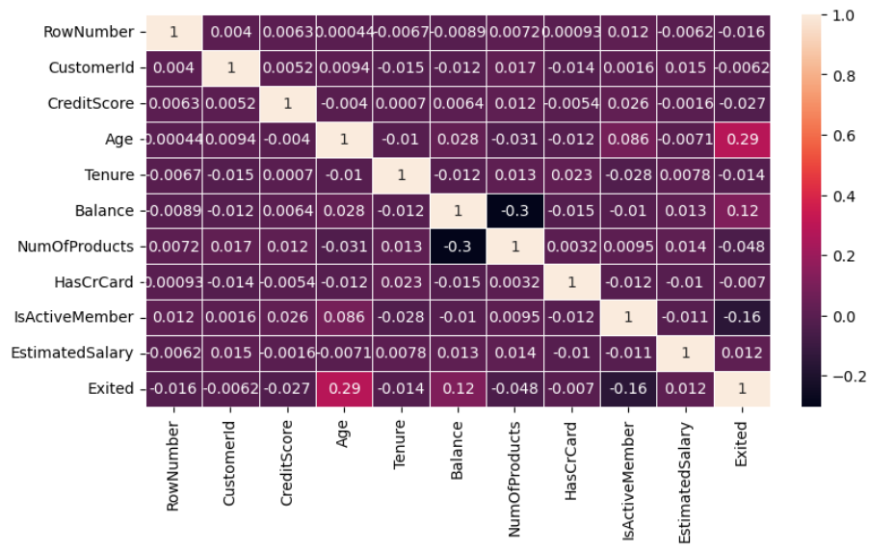
Bi-Varient Analysis(Numerical Vs Numerical)
The above heatmap helps us to identify which variables might be important for predicting customer churn.
Age and Exited are having strong correlation which indicates that the older customers are more likely to leave (or churn).
Most other variables like salary,creditscore and balance shows the weak correlation with churn which means they have predictive power for target variable(churn).

Slide 11
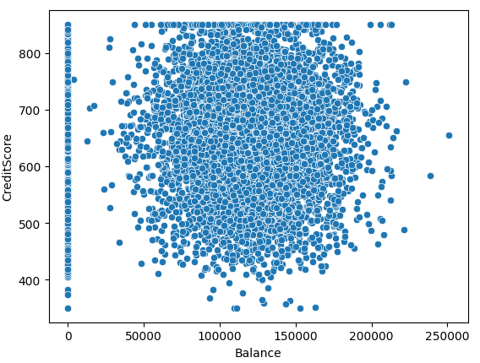
K-Nearset Neighbors Algorithm
The image shows the scatter plot which visualises the relationship between the customer’s account balance and their creditscore.
The x-axis represents the customer balance which ranges from 0 to about 250,000 .
The y-axis represents the customer creditscore which ranges from 400 to 850.
The vertical line at 0 represents the most number of the customers are having zero balance regardless of their creditscore.

Slide 12
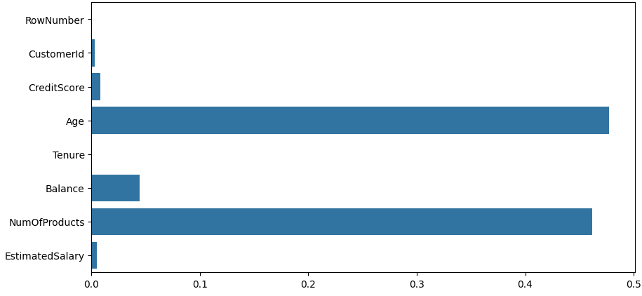
Decision Tree Regressor Model
The image shows the Decision Tree regressor model.It shows the contribution of each feature to the decision tree models.
Higher values indicate a greater importance of that feature in making predictions.
From the above plot ,Age and NumOfProducts appears to have the highest importance scores .Balance is having the moderate importance.

Slide 13
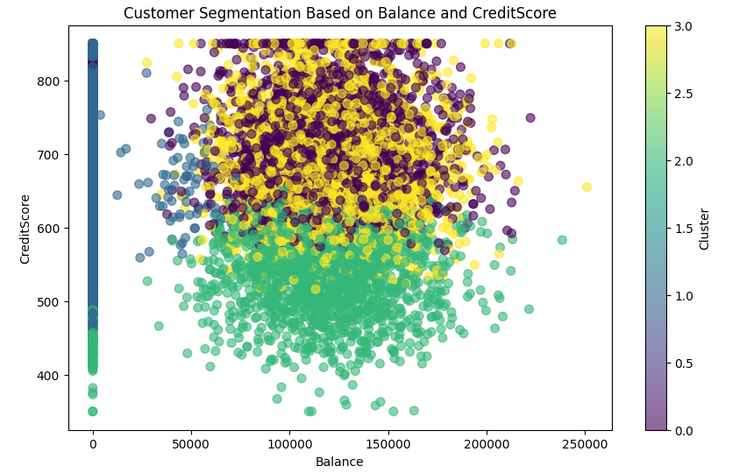
Customer Segmentation(k-means clustering)
The image shows the scatterplot used for customer segmentation ,based on Balance and CreditScore.
The x-axis represents the Balance and y-axis represents creditscore.
On the right side there is a color bar labelled ‘cluster’,showing the range from 0.0 to 3.0.Each color on the scatter plot corresponds to one of these clusters.
The clustering has been applied using a machine learning (k-means clustering) to categorise the customers into different segments based on balance and credit score.
By analysing clusters,we can identify the patterns such as high balance and high creditscore(or) low creditscore and low balance.

Slide 14
Conclusion:
The Bank Churn Data provides the valuable insights into the factors, that influence the customer demographic information suchas(age,gender,customerId,CreditScore,……)
From the analysis several key insights can be drawn:
1.Customer Profile of Likely Churners:customers with specific ages, account balances, and tenure lengths may be at higher risk of leaving.
2.Influential Factors in Churn: Features such as customer age, account balance, credit score, and tenure within the bank have shown significant influence on churn propensity.
3.Geographical and Gender Differences:customers from certain regions or of a specific gender may exhibit higher churn rates.
4.Credit Score Improvement Initiatives: Customers with lower credit scores have shown higher churn tendencies.

Slide 15
THANK YOU!

